Slide 1


Slide 2
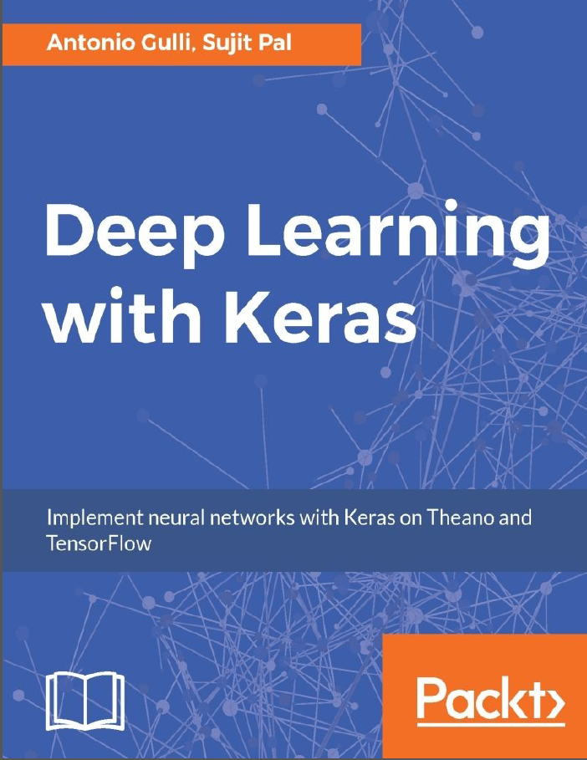
Starting Deep Learning with Python – Keras –
Ingyu Lee
Troy University
https://github.com/GoTrojan/DeepLearning

Slide 3
Contents
What is this talk about?
Introduce Deep Learning with KERAS.
Who needs this talk?
Who are interested in Deep Learning and about to start develop one.
What will be covered?
How to start with deep learning with KERAS.
What will not be covered?
Detail applications on deep learning.
Theory on deep learning.
If you are already familiar with KERAS or other deep learning platform, then this is not good for you.

Slide 4
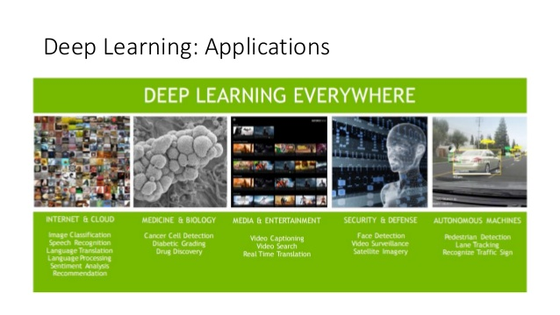
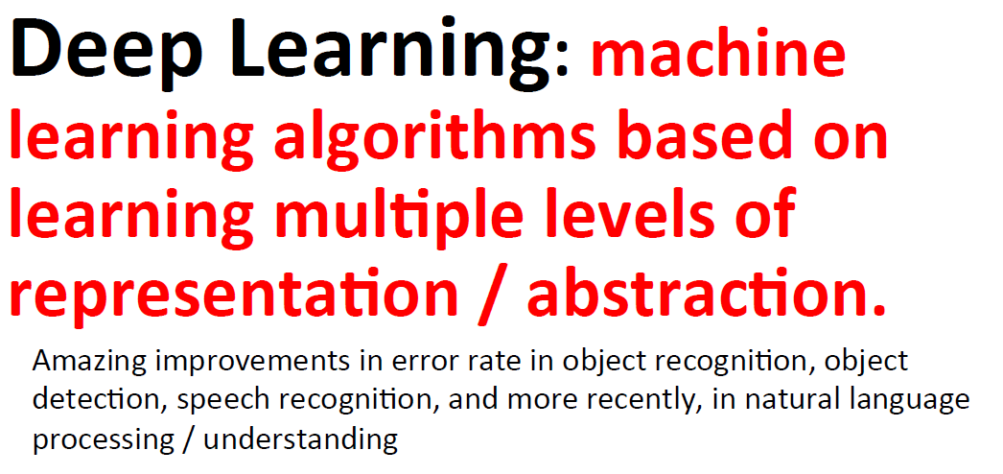
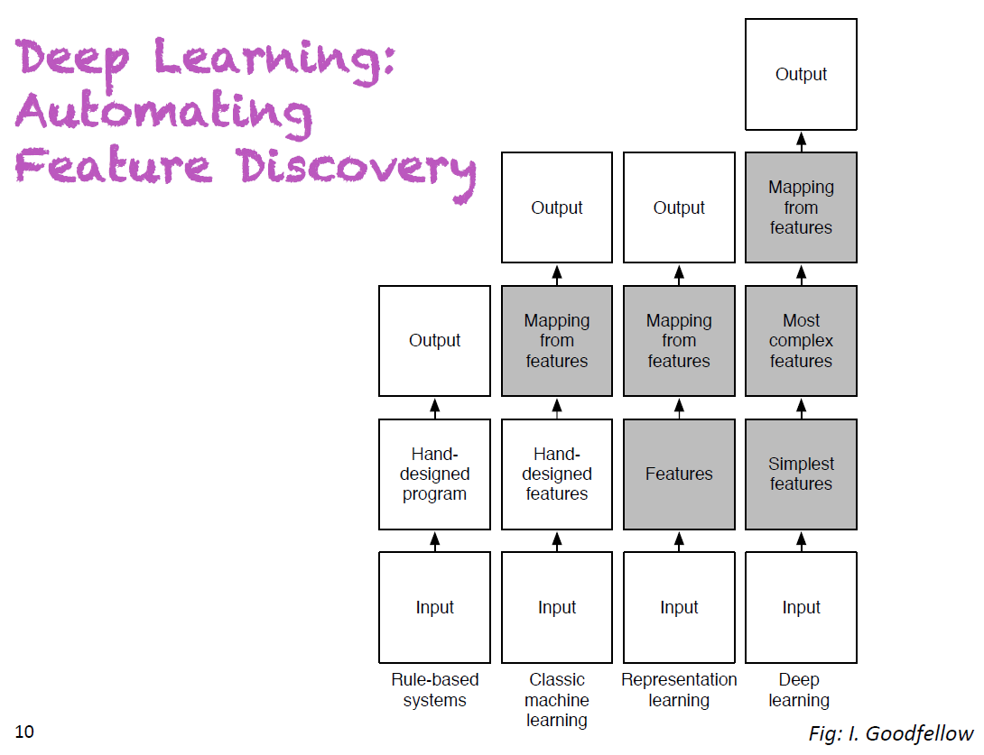
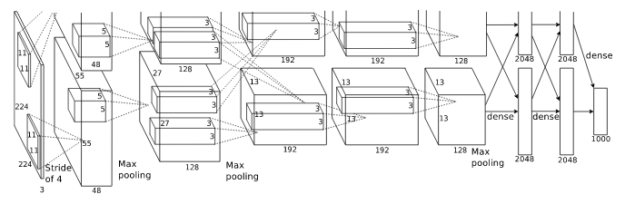
What is Deep Learning?
https://papers.nips.cc/paper/4824-imagenet-classification-with-deep-convolutional-neural-networks.pdf

Slide 5
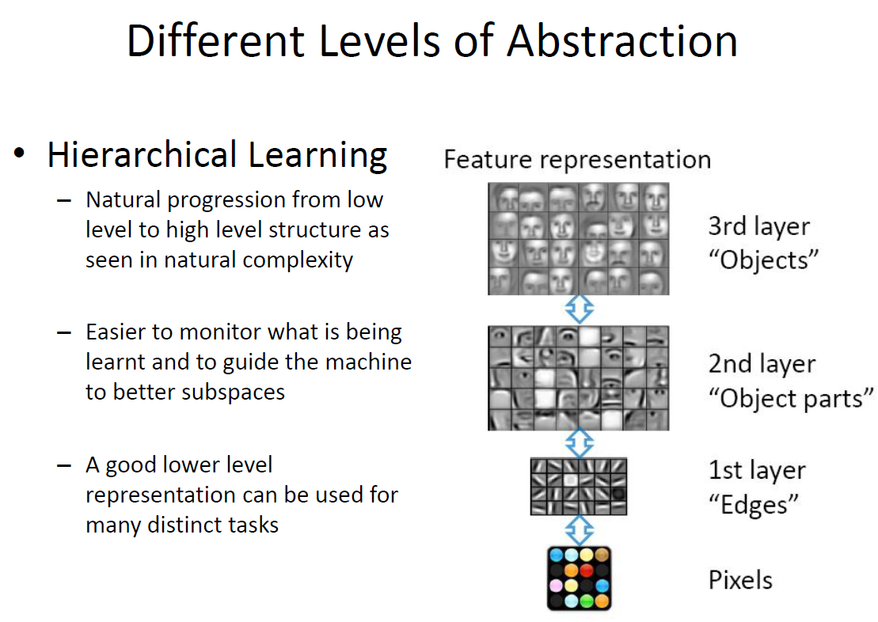
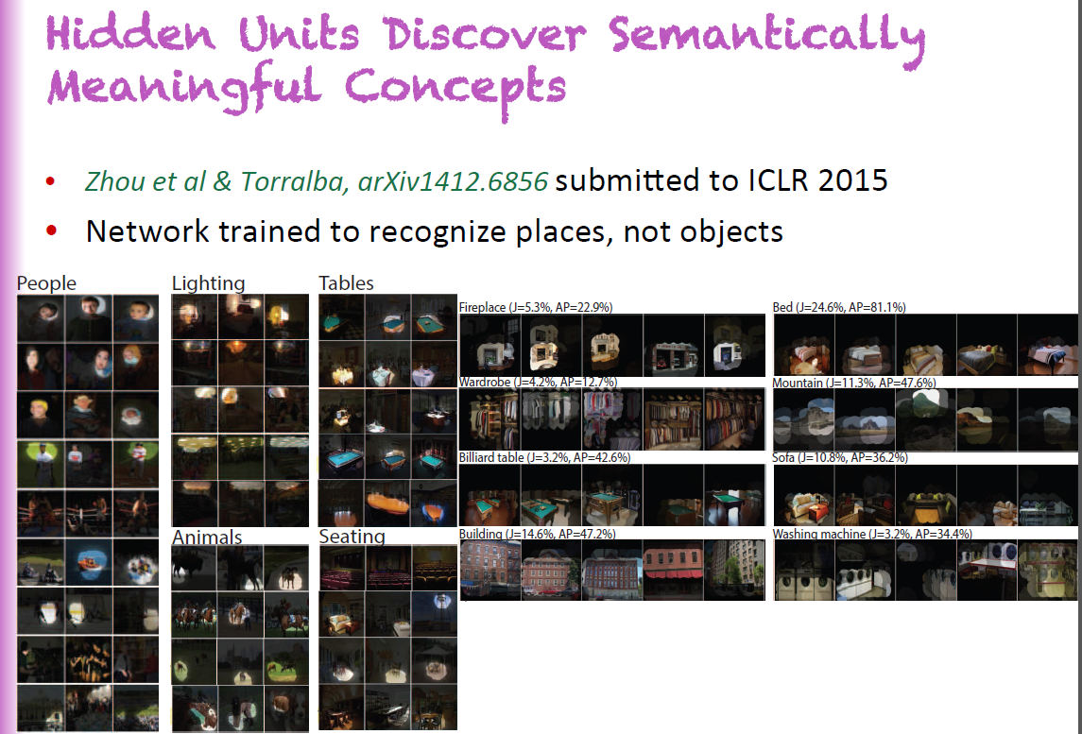
Why Deep Learning?

Slide 6
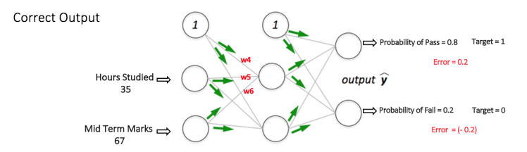
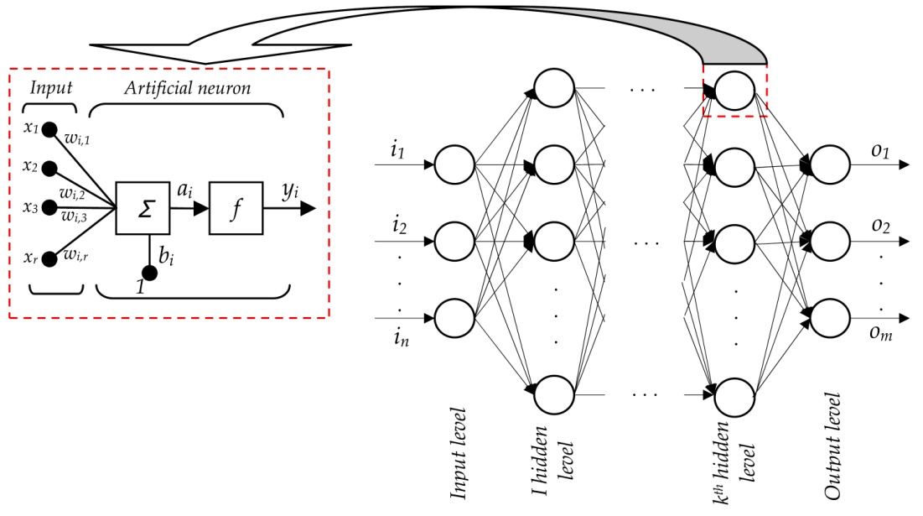
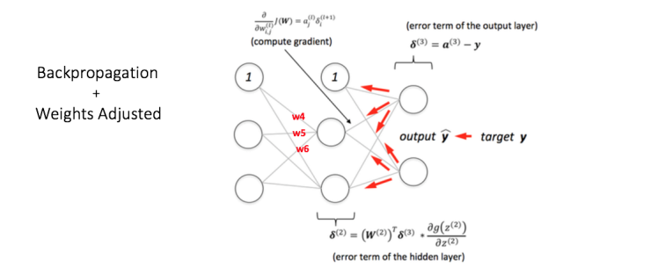
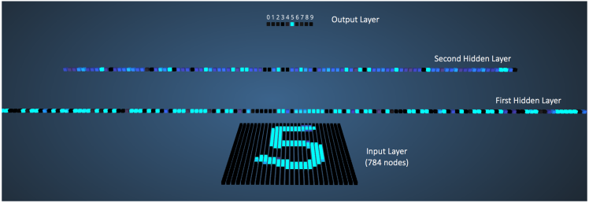
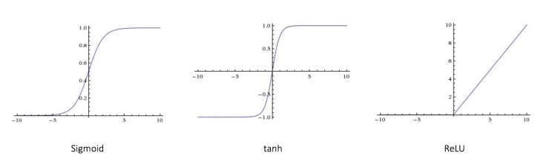
Background

Slide 7
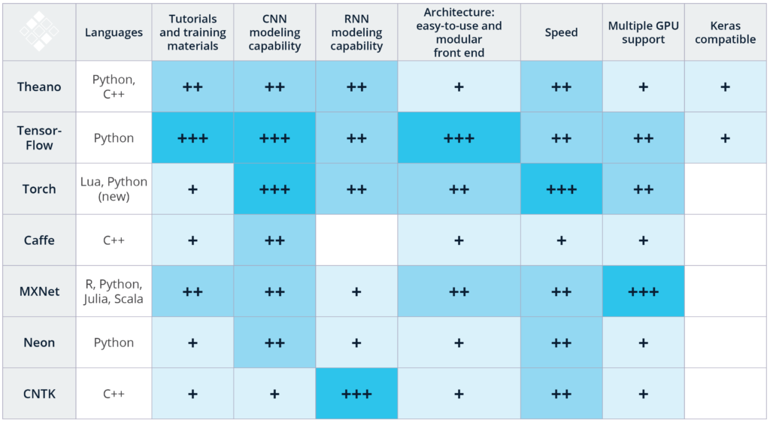
Deep Learning Frameworks

Slide 8
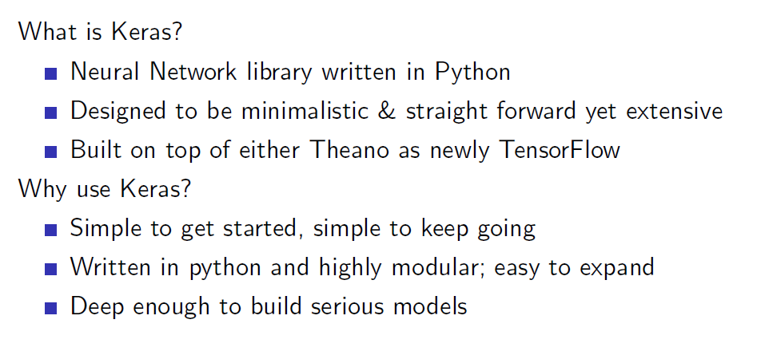
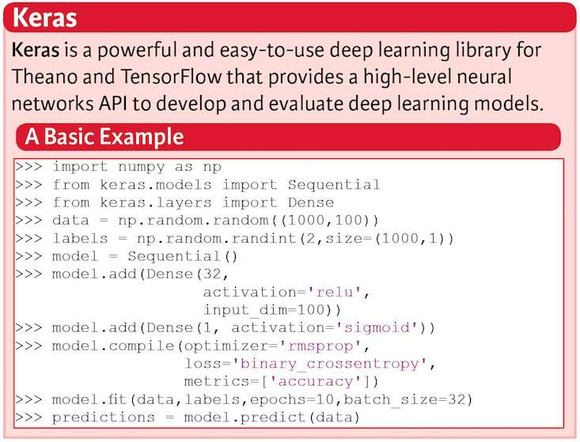
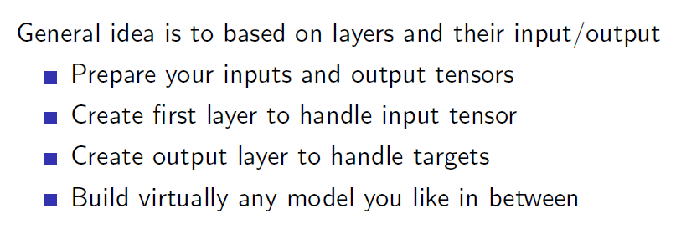
Keras

Slide 9
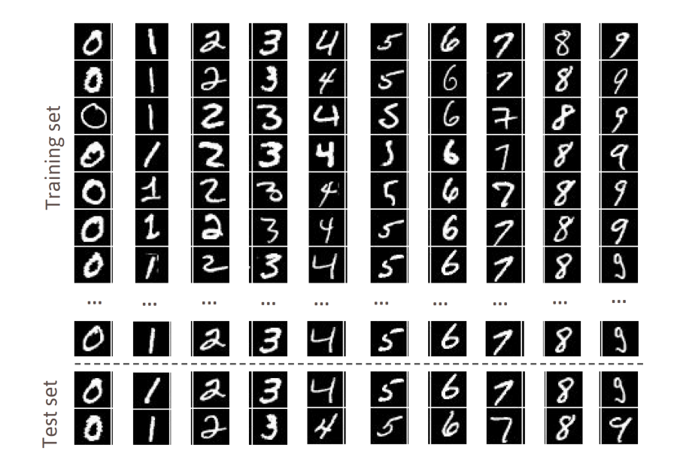
First Applications
28 x 28 pixels
We will build a neural network that can recognize handwritten numbers.
We use MNIST (a database of handwritten digits made up of a training set of 60,000 examples and a test set of 10,000 examples.
The examples are annotated by humans with the correct answer. Since a database with correct answers is available, we can perform a supervised learning.

Slide 10
Step 1: Set up your environment
Python 2.7+
SciPy and NumPy
Matplotlib
Theano
Tensorflow
sudo apt-get update
sudo apt-get install python-pip python-dev build-essential
sudo pip install --upgrade pip
sudo pip install ipython
sudo apt-get install libopenblas-dev liblapack-dev gfortran python-numpy python-scipy
sudo pip install matplotlib scikit-learn scikit-image protobuf jupyter
sudo pip install tensorflow
sudo pip install Theano
sudo pip install keras

Slide 11
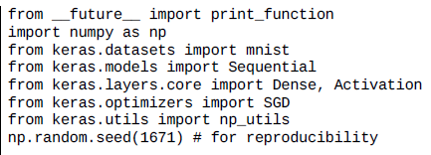
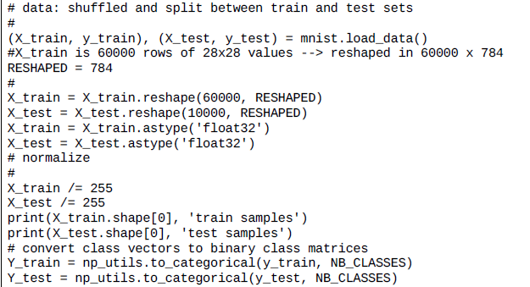
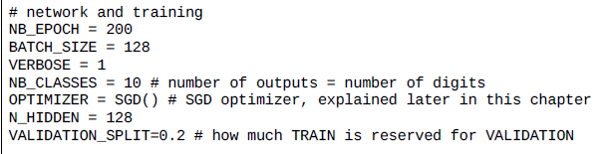
Step 2: Import the libraries and dataset

Slide 12
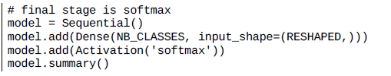
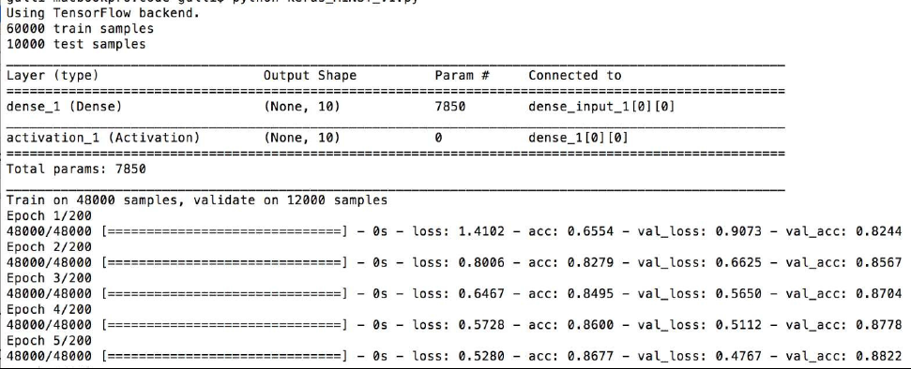
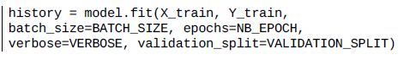
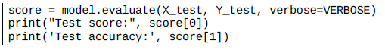
Step 3: Define networks and run the model

Slide 13
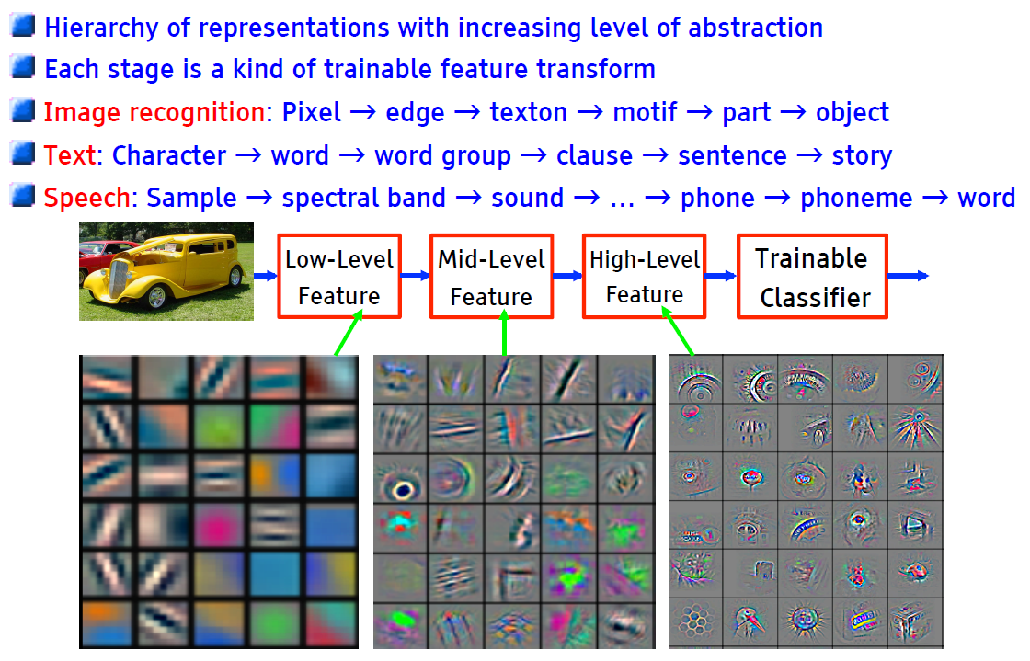
Why Multiple Layers? The World is Compositional

Slide 14
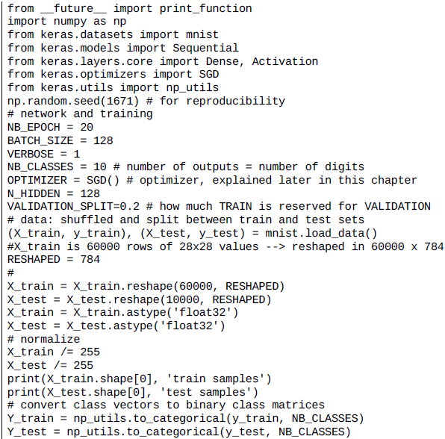
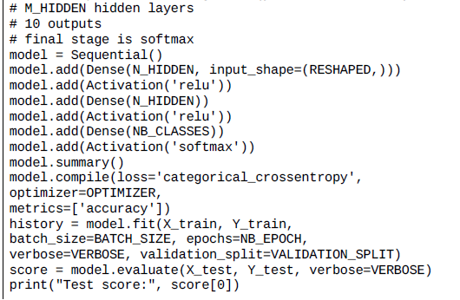
Improve the model with hidden layers

Slide 15
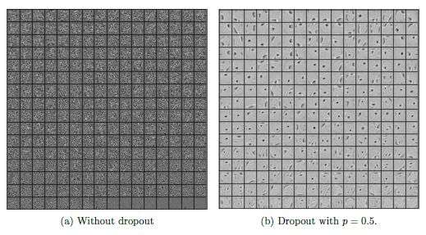
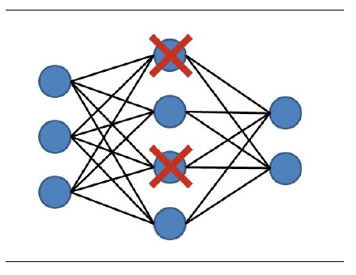
What is dropout?
During the learning phase, the connections with the next layer can be limited to a subset of neurons to
reduce the weights to be updated, this learning optimization technique is called dropout. The dropout is therefore a technique used to decrease the overfitting within a network with many layers and/or neurons.

Slide 16
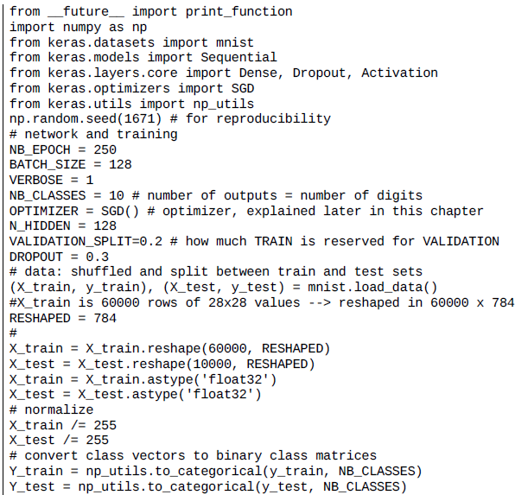
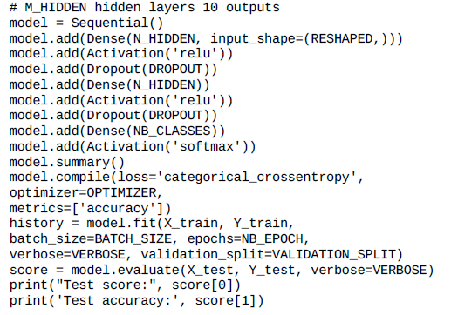
Further improvement with dropout

Slide 17
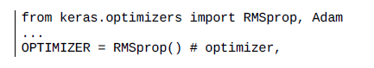
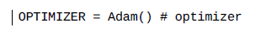
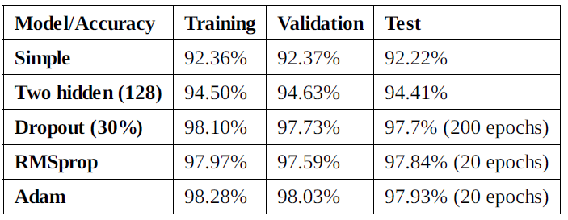
Other Improvements
Use different optimizers in Keras
Stochastic gradient descent (SGD)
RMSprop and Adam
Increasing the number of epochs.
Controlling the optimizer learning rate.
Increasing the number of internal hidden neurons.
Increasing the size of batch computation.
Adopting regularization for avoiding overfitting.

Slide 18
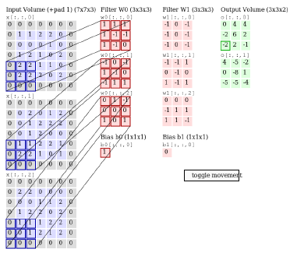
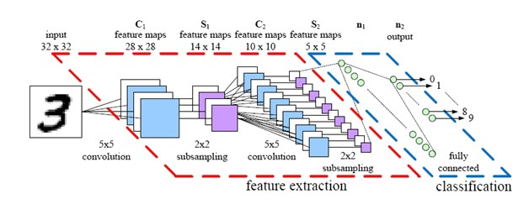
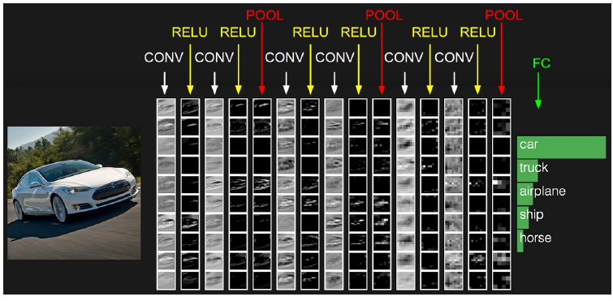

Convolutional Neural Network (CNN)
Key intuitions beyond ConvNets
Local receptive fields
Shared weights
Pooling

Slide 19
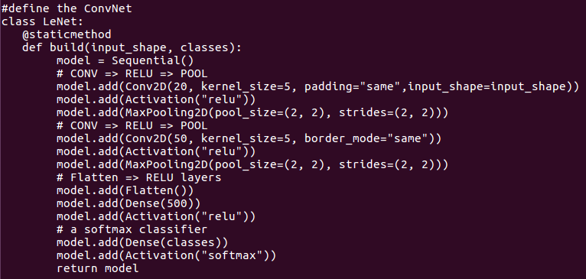
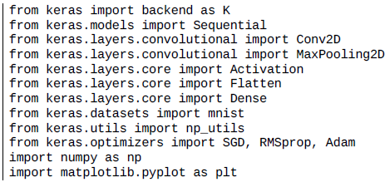
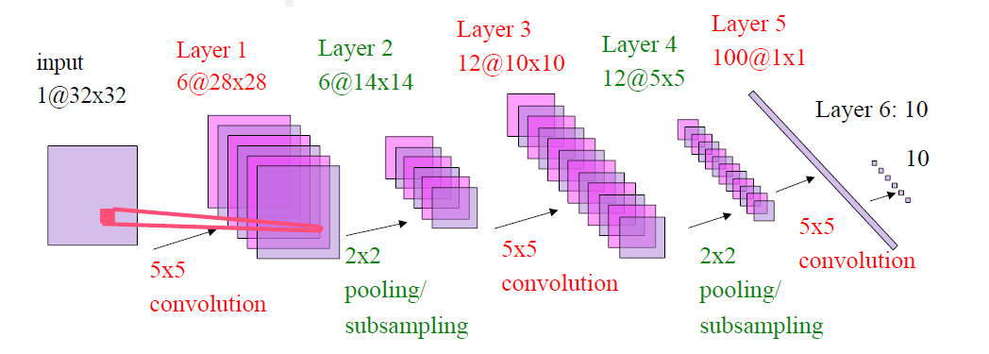
Example of CNN: LeNet

Slide 20
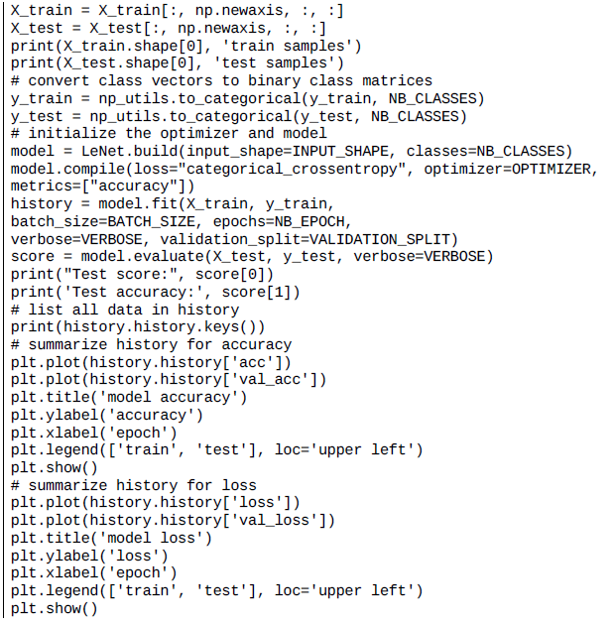
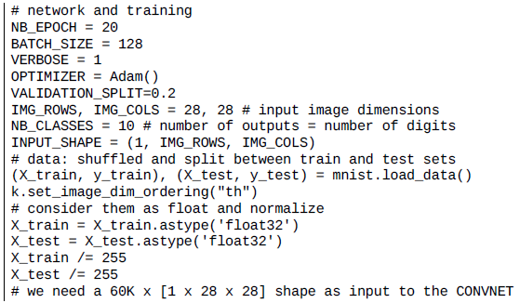
Example of CNN: LeNet

Slide 21
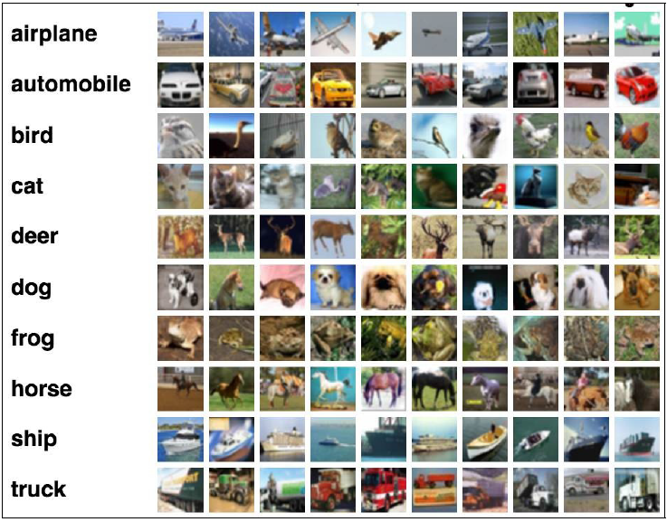
Recognizing CIFAR-10 images with deep learning
The CIFAR-10 dataset contains 60,000 color images of 32 x 32 pixels in 3 channels divided into 10 classes.
Each class contains 6,000 images. The training set contains 50,000 images and test sets provides 10,000 images.
The goal is to recognize previously unseen images and assign them to one of the 10 classes.

Slide 22
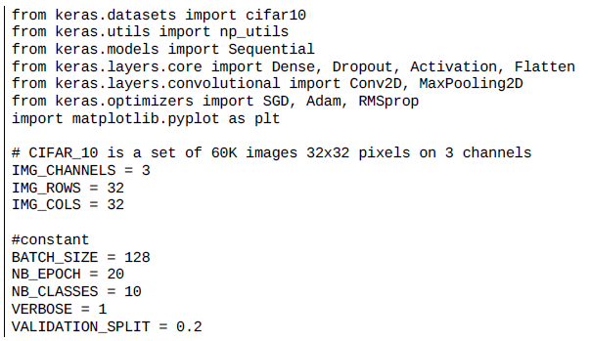
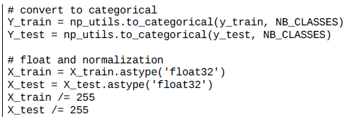
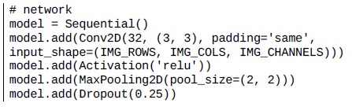
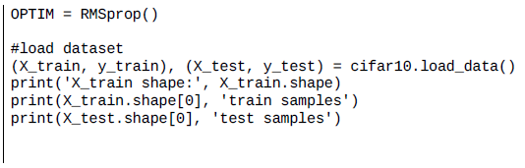
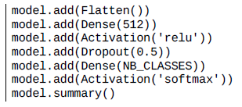
Recognizing CIFAR-10 images with deep learning

Slide 23
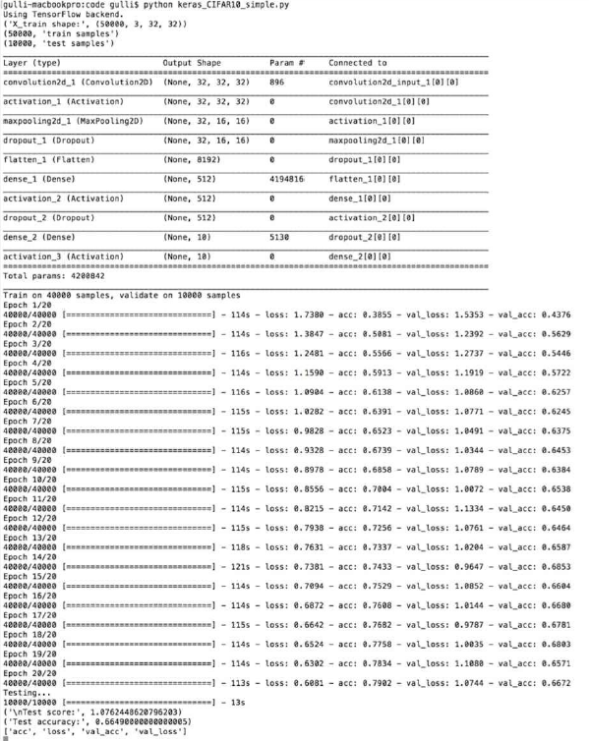
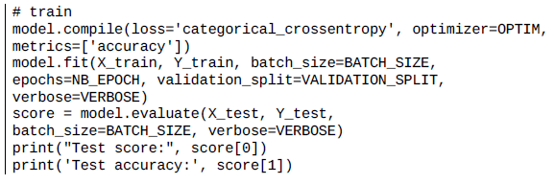

Recognizing CIFAR-10 images with deep learning

Slide 24


Improving the CIFAR-10 performance with deeper network

Slide 25



Improving the CIFAR-10 performance with data augmentation

Slide 26


Very deep convolutional networks for large-scale image recognition

Slide 27

Very Deep ConvNet Architectures

Slide 28

Back To Keras: Layers and Layers

Slide 29



Layers and Layers

Slide 30

Activations

Slide 31

Objectives and Optimizers

Slide 32

Parallel Capabilities

Slide 33

Architecture/Weight Saving and Loading

Slide 34

Callbacks

Slide 35

In Summary
Thanks for your attentions !

